Slide 1

Theater management system
Team members:
Saugat Pokhrel(THA081BEI036)
Shikshit Bhattarai(THA081BEI039)
Sparsh Bashyal(THA081BEI044)
Yogesh Aryal(THA081BEI048)
Department Name:
Department of computer and electronics engineering,
INSTITUTE OF ENGINEERING,THAPATHALI CAMPUS

Slide 2
INTRODUCTION
This project aims to develop a Theater Management System using the C programming language. The system will provide a console-based interface for managing theater operations, including ticket booking, seat management, movie scheduling, and customer management.
The project will focus on creating a robust and efficient system using C, leveraging its low-level capabilities for performance and reliability.

Slide 3
Table of contents
Cover page……………………………………………….. 1
Introduction……………………………………………….. 2
Table of contents..……………………………………….. 3
Objectives………..……………………………………….. 4
Scope and limitations ….……………………………….. 5
Development Methodology….………………………….. 6
Requirement analysis ………………………………….. 9
Feasibilty study …………...…………………………….. 10
System……….. …………...…………………………….. 11
Future recommendation...…………………………….. 13
Conclusion……………………………………………….. 14
Appendix……………..…………………………………... 15

Slide 4
Objectives
Autamate ticket booking and seat allocation
Provide an intuditive interface for users and administrators
Improve customer experience through digital solution

Slide 5
Scope and Limitation
Scope
Enable customers to book ticket online with real-time seat availability option.
Allow admins to manage movie listing,show timings efficiently.
Provide role based access for customer and admin.
Limitations
It does not allow users to perform digital payments.
It does not allow user to select movie time

Slide 6
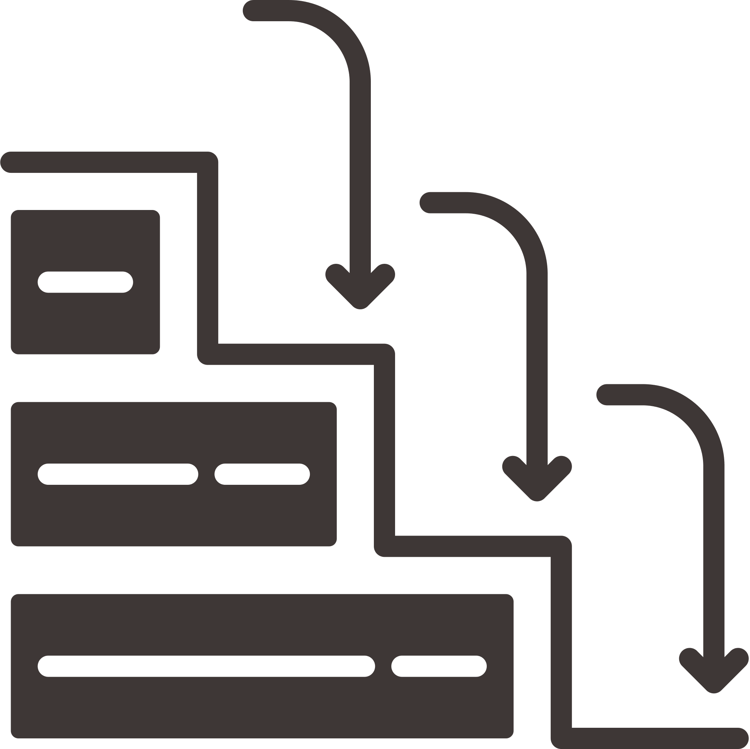
Development Methodology
Waterfall Model
Since the project requirements are well-defined, stable and not expected to undergo significant changes. The Waterfall Model was selected for its ability to provide a controlled and predictable development process, catering to the specific characteristics and requirements of our project.

Slide 7
The requirement analysis phase helped in defining core functionalities like movie management, seat booking, and authentication.
The system design ensured modularity, making the system easier to understand and extend.
The implementation phase successfully utilized C programming with file handling and data structures for efficient functionality.

Slide 8
Testing verified the reliability of the system, handling errors and ensuring smooth operation.
The deployment phase demonstrated that the system can run in a terminal-based environment with persistent data storage.
Future maintenance and enhancements can include GUI implementation, better security, and additional features like user accounts and cancellation options.

Slide 9

Requirement analysis
Fundmental requirement
User can select movie and seat.
Admin can monitor users, manage movie data and access system logs.
Non fundamental requirements
System must be fast, scalable, secure, and user friendly.

Slide 10

Feasibility Study
Technical Feasibility – Evaluates whether the required technology, software, and infrastructure are available for system implementation.
Operational Feasibility – Assesses how well the system meets theater management needs, improves efficiency, and enhances user experience.
Economic Feasibility – Determines the cost-effectiveness of the project, including development, maintenance, and return on investment.
Scheduling Feasibility – Examines whether the project can be completed within the given time frame and resource availability.

Slide 11
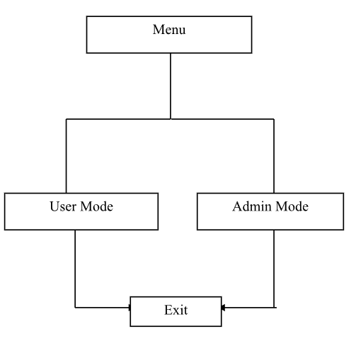
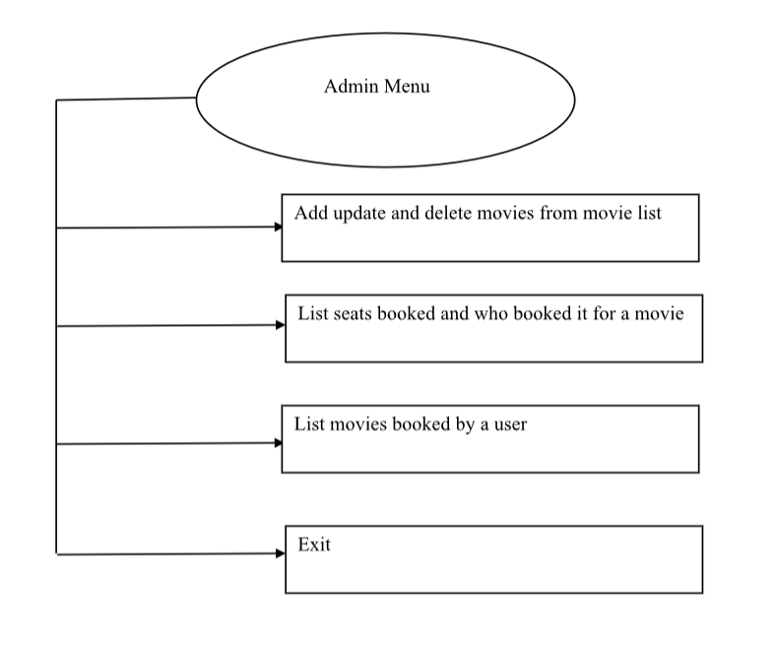
System
Block Diagram of entry point
Block Diagram of admin menu

Slide 12
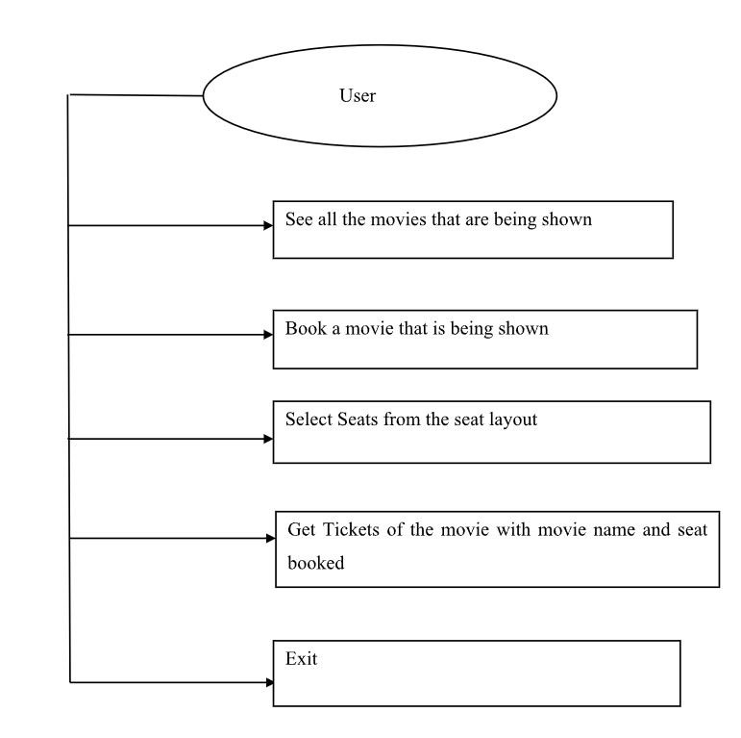
Block Diagram of users menu

Slide 13
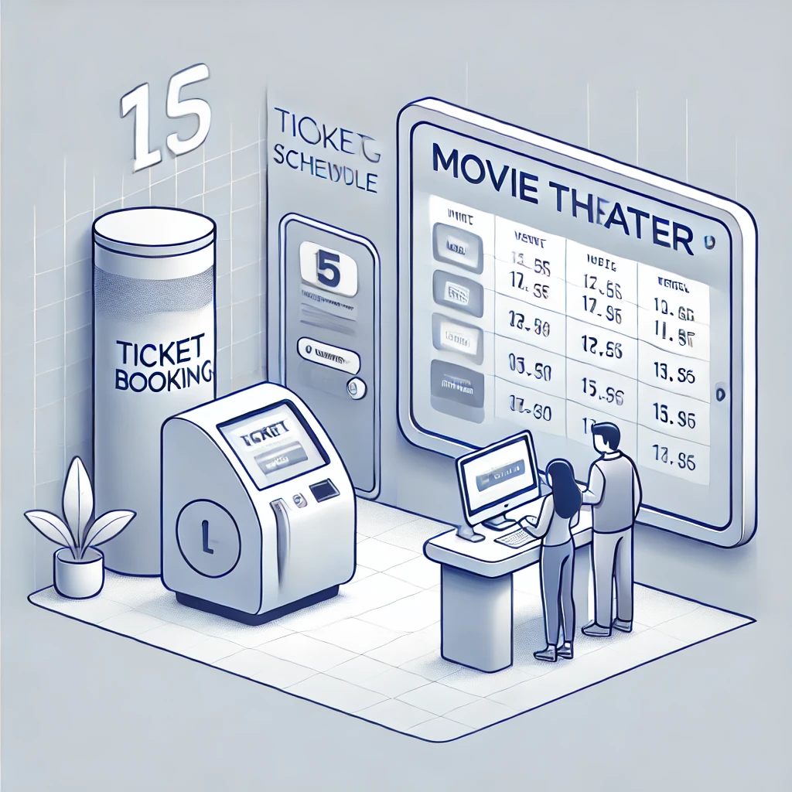
Future recommendation
AI-Powered Personalization – Implement AI-driven recommendations based on user preferences, viewing history, and real-time trends.
Smart Ticketing & Contactless Entry – Integrate QR code-based or facial recognition ticketing for a seamless and secure entry experience.
Digital payment – Integrate online payment method using Esewa, Khalti and Bank transfer.

Slide 14
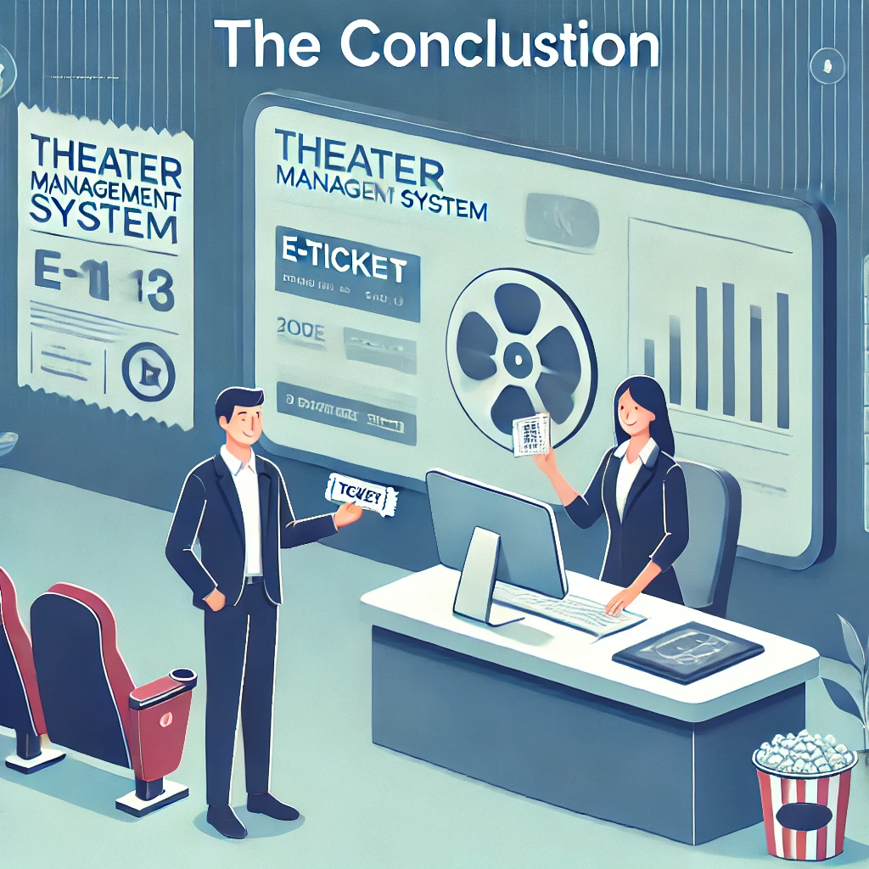
Conclusion
It simplifies the management of theater using c programming language
The system effectively enhances user engagement by providing accurate, fast booking facility

Slide 15
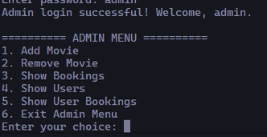
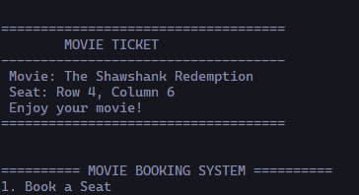
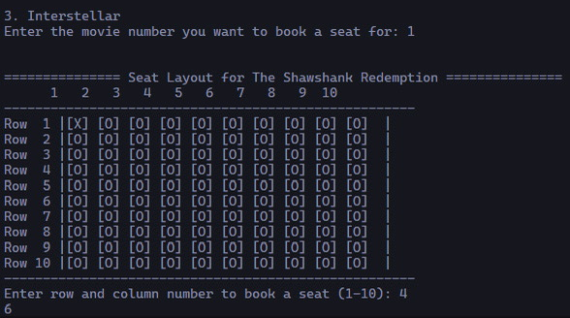
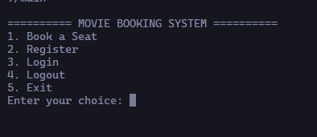
Appendix

Slide 16
